Slide 1
Customer Churn Analysis
Presented by: Joshua
Last Updated: November 11th 2024

Slide 2
Table of Contents
Objective
Data Analysis and Insight
Recommendation
Conclusion
Question
Appendix

Slide 3
objective
As we know, it is much more expensive to sign in a new client than keeping an existing one.
Our objective to significantly reduce our churn rate by finding out the key factors that leads a client towards the decision to leave the bank.

Slide 4
Data Analysis and Insights
We conducted a correlation analysis between exited customers and other variables Based on the correlation values (Figure shown in appedix), The following variables seem to be significantly correlated.
Compliant
Age
Customer Balance
Number of Products
Is Active Member?
Notes:
Talk about the data you received in this case the first party data acquired from the company

Slide 5
Data Analysis and Insights
2044 Customers Complained and 2034 people (99.5%) exited after complaining. This indicates that customers who file complaints are almost always likely to leave. Complaint management and resolution processes are likely critical to retention.

Slide 6
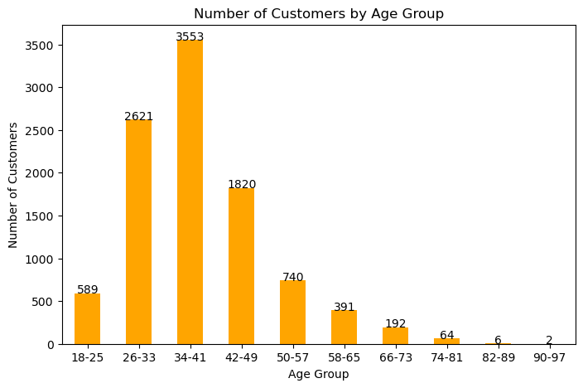
Data Analysis and Insights
It may seem that Older Customers (Age group 46-55 and 56-65) are more inclined to leave

Slide 7
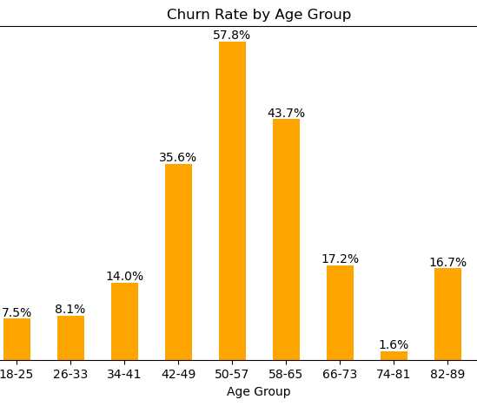
Data Analysis and Insights
It may seem that Older Customers (Age group 46-55 and 56-65) are more inclined to leave

Slide 8
Customer Balance and Satisfication
Our analysis shows that;
The average balance of customers who stayed is approximately $72,743 and customers who exited is approximately $91,109.
This suggest that customers with higher balances might be more likely to leave, indicating a possible disconnection with how the bank meets the needs of wealthier clients
Further analysis into the satisfaction score of the High balance clients and the dataset as a whole were similar at approximately 3 out of 5

Slide 9
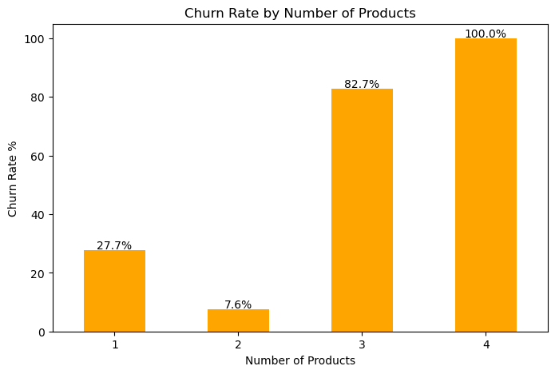
High product ownership typically suggests strong engagement. However, if high product users are more prone to churn, it may indicate dissatisfaction with the offered products or a disconnect between the products’ perceived value and customers’ expectations.

Slide 10
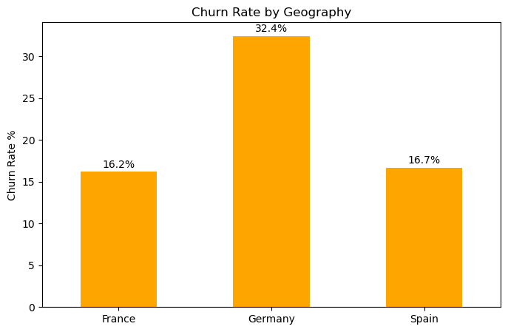

Slide 11
Recommendations
Complaint management and resolution processes are likely critical to retention.

